Slide 1
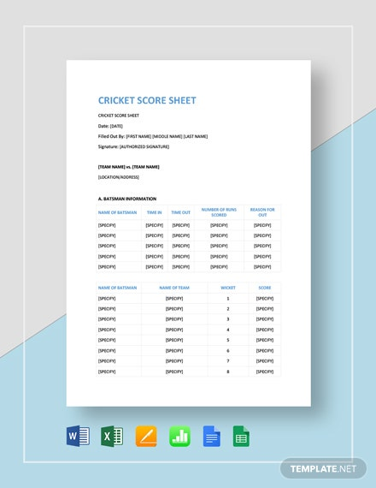
Problem solving and algorithmic thinking
CRICKET SCORE SHEET
GROUP NO : 7 ccea
DONE BY :
GREESHMA – CCEA.21722
R RANGASHREE DHANVANTH – CCEA.21006
DHASHYANTH – CCEA.21428
SARATH – CCEA.21707
SANJAY – CCEA.20754

Slide 2
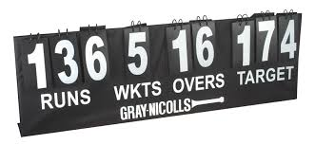
PROBLEM DEFINITION
In cricket the score of each team decides the
Winner of the game . The scores of both the teams will be displayed in a score sheet.
A score sheet is a designed sheet which displays the runs, wickets, names of the batsman and bowlers, overs, extras, economy of the bowler, strike rate of the batsman etc. So here we are going to make a cricket score sheet

Slide 3
PROBLEM DEFINITION GIVEN IN THE QUESTION
The design can display runs, wickets, names of batsmen and bowlers, overs, extras, economy of bowler, strike rate of batsmen, etc. It also displays the date and time of the game.
• First the project should display the welcome screen and the main menu.
• The main menu comprises three options namely:
1. New Score Sheet
2. View Score Sheet
3. Exit
• If ‘1’ is entered, Cricket Score Sheet project asks for the name of new score sheet. When the sheet is created, a message is displayed on the screen. Then, the score sheet appears on screen in which the user must input the following information:
1. Competition
2. Venue
3. Match versus
4. Toss winner team

Slide 4
5. Elected choice of toss winner
6. Innings and date
7. Name of batsman and run hit by each of them
8. Name of bowler and run given by each bowler
• After inputting these data, the design asks user to input ‘e’ to edit the data and ‘c’ to continue.
• If the user inputs ‘2’ in the main menu, the design asks for the name of sheet. If the sheet is found, it is displayed. Otherwise, error message is printed on the screen.
• The third option in main menu is exit. If ‘3’ is entered in the main menu, the Cricket Score Sheet project terminates.

Slide 5
PROBLEM DECOMPOSITION
S.NO | PROBLEM | DESCRIPTION
1. | A proper menu should be displayed. | Proper menu should be displayed like the new score sheet, the old score sheet and the exit option.
2. | Getting the required inputs from the user. | Proper inputs should be given for a better output.
3. | Designing an algorithm for calculating the scores instantly. | For each ball the score card should change for that we have to create a proper algorithm to make this program work.

Slide 6
SUB PROBLEM : 1
A MENU SHOULD BE DISPLAYED TO MAKE THE USER KNOW WHAT THE GIVEN OUTPUT IS ABOUT.
THE MENU SHOULD CONTAIN THE NEW SCORE CARDS , THE SCORE CARDS OF THE PREVIOUS MATCHES AND THE EXIT OPTION.
A PROPER MENU GIVES THE USER TO GET THE CHOICE AND PERFORM THE REQUIRED ACTIONS.

Slide 7
SUB PROBLEM : 2
THE INPUTS SHOULD BE GIVEN CORRECTLY TO GET THE REQUIRED OUTPUT WHICH IS THE SCORECARD OF THE REQUIRED MATCH.
FOR EXAMPLE THE USER NEEDS TO WRITE THE DATE OF THE MATCH , THE VENUE OF THE MATCH ,THE NAME OF THE TWO TEAMS AND THE NAME OF THE SERIES.
BY GIVING THESE INFORMATION WE CAN GET THE SCORECARD OF THAT PARTICULAR MATCH.
THE USER CAN ENTER THESE INFORMATIONS AFTER CHOOSING ANY OF THE TWO OPTIONS IN THE MENU.

Slide 8
SUB PROBLEM : 3
WE HAVE TO DESIGN AN ALGORITHM TO ACCEPT TO ACCEPT THE INPUT AND SAVE IT.
DESIGNING AN ALGORITHM TO SEARCH A PARTICULAR SCORECARD AND DISPLAY IT IN THE OUTPUT BOX.
THE ALGORITHM SHOULD BE SUCH THAT IT SHOULD CALCULATE THE ECONOMY, STRIKE RATE, THE NUMBER OF BALLS COMPLETED AND THE EXTRAS AND PRINT IT.

Slide 9
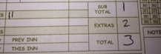
ABSTRACTION
If the scorecard is handwritten ,it makes too difficult to note small details ball to ball. So we can neglect the following points:-
Extras includes runs scored from no ball ,wide ball ,bye run ,leg-bye and penalty run. So instead of marking all separately, we can just add the runs under ‘Extras’, even though it was scored in no ball or wide ball.
If it is a simple scorecard, we can exclude calculation of net run rate per over, strike rate of batsmen and economy of the bowler.

Slide 10
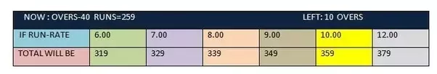
If the scorecard is programed, many details can be noted and calculated easily. But the following are some details which can be neglected:-
Prediction of runs at the end of an innings as per net run rate and possible run rate.
Duckworth-Lewis method calculation makes the program too difficult such that its removal will reduce work load. It is required only in some unexpected situations like bad weather(rain),etc. So if it is neglected also, it wont create any problem.
Information and past records about the player is an unnecessary information so we can avoid that as well.

Slide 11
Pattern recognition
BY SEEING THE PREVIOUS SCORE SHEETS WE FOUND OUT THAT SOME OF THE INFORMATIONS ARE MANDATORY.
THOSE ARE THE NAME OF THE TWO TEAMS, VENUE, DATE OF THE MATCH, NAME OF THE BOWLER AND THE BATSMAN. THEN COMES THE RUNS, OVERS AND THE WICKETS.
FROM THE PAST SCORE SHEETS WE CAN CONCLUDE THAT VENUE, NAME OF THE TWO TEAMS, NAME OF THE BOWLER AND THE BATSMAN CAN BE WRITTEN BY USING THE STRING DATA TYPE.
THEN COMES THE RUNS, OVERS, WICKETS AND EXTRAS WHICH CAN BE WRITTERN BY USING THE INTEGER DATA TYPE.
FLOAT IS A DATA TYPE WHICH IS USED TO WRITE THE RUN RATE, ECONOMY AND THE STRIKE RATE.

Slide 12
Input & Output design of score card
Here the input data is to be given by users and the output design is the cricket score card.
As the game is so important the score can be changed if it is accessed by any people so for security purpose we should design the score card by entering a valid user id and pass word related to the team & should be accessed only by the authorities.(Valid user name which should be available in the database)
Then the authorities will be able to access and they will input the scores according to the game play.
The score card may also contain commentary box.

Slide 13
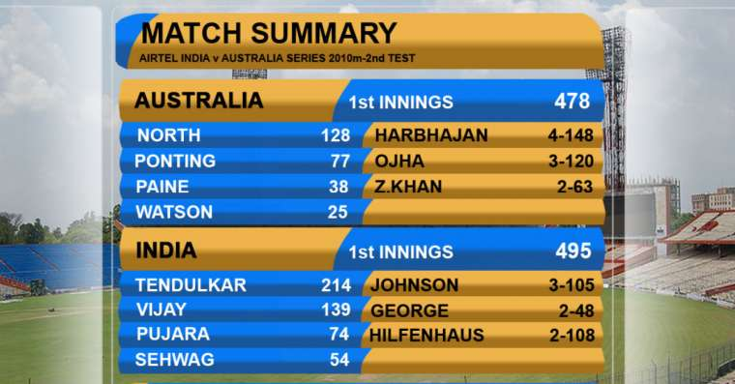
Display of the score card
After entering the valid input from the end users(details of the match)Finally the output will be the score sheet which contains the names of the players and their respective scores.
Example of score sheet:

Slide 14
ALGORITHM

Slide 15
Step 1.Start
Step 2.Intialise the variables integer(number, wicket, score ) & String(Name, competition, venue, Date )
Step 3.Output “Select the screen that u need u display 1.New score sheet 2.View score sheet 3.Exit”
Step 4.If “1” is entered the new score sheet is displayed in which the user has to input the information.
Step 5: Output ("WELCOME!
MENU
Enter:
1. New Score Sheet
2. View Score Sheet
3. Exit
Enter your choice : ")
Step 6 Do :
Step 5.2.1: Input choice
Step 5.2.2: if (choice != 1 and choice != 2 and choice != 3):
Step 5.2.2.1:output ("Please enter the correct choice number(1/2/3) ")
step 7:While (choice != 1 and choice != 2 and choice != 3)

Slide 16
Step 8: if choice == 1:
i = i + 1
Do :
Step 1:output("Enter the name of the scorecard : ")
Step 2: input scorecard
Step 3: score card list[i] = scorecard
Step.4: output("Enter the competition name: ")
Step.5: input competition[i]
Step.6: output("Enter the venue")
Step.7: input venue[i]
Step.8: output("Enter the playing teams.
Team 1 : ")
Step.9: input teams[2 * i]
Step.10: output("Team 2 : ")
Step.11: input teams[2 * i + 1]

Slide 17
Step 9: Output ("Enter the toss winner team : ")
Step 1: input tosswinner[i]
Step 2:output("Enter the outcome of the toss : ")
Step 3: input toss[i]
Step 4: output("Enter the innings")
Step 5: input innings[i]
Step 6: output("Enter the date : ")
Step 7: Input date[i]
Step 8: Assign runs[i] = 0
Step 10:
Step1: output("Enter the name of the batsman : ")
Step.2: Input batsman[k]
Step 3: output ("Enter the number of runs scored : ")
Step 4: Input batruns[k]
Step 5: Assign runs[i] = runs[i] + batruns[k]
Step 6: output("Enter the number of balls faced : ")
Step 7: Input bat balls[k]

Slide 18
Step 11: if batballs[k] == 0:
Assign strikerate[k] = 0
else:
Assign strike rate[k] = (bat runs[k]) / bat balls[k]) * 100
Step 12: for (k = (11 *i to (11 * i) + 10 ), 1):
Step 1: output "Enter the name of the bowler : ")
Step 2: Input bowler[k]
Step 3: output("Enter the number of overs bowled by the bowler : ")
Step 4: Input bow overs[k]
Step 5: output("Enter the number of wickets taken by the bowler : ")
Step 6: Input bow wickets[k]
Step 7 : output("Enter the number of runs given by the bowler : ")
Step 8: Input bow runs[k]
Step 9: Assign ov = bow overs[k]
Step 10: if bow overs[k] == 0:
Step 11: economy[k] = 0
else:
Assign economy[k] = (bow runs[k] / (ov + (bow overs[k] - ov)

Slide 19
Step 13: output("Enter the runs scored by extras : ")
Step 1 :Input extras[i]
Step 2: Assign runs[i] = runs[i] + extras[i]
Step 3:output ("Enter the number of wickets fallen : ")
Step 4: Input wickets[i]
Step 5: output ("Enter your choice:”
e to edit
c to continue(Or press any other key to continue)
Step 6 : Input ch
Step 14 : While (ch == "e")
Step 1: if choice == 2:
Step 2: scorecard = “ABC"
Step 3: output("List of scorecards : ")
Step 4: for ( j = 0 to i , step 1):
Step 5: print((j + 1), " . " ,score card list[j])
Step 6: output("Enter the name of the scorecard : ")
Step 7: Input scorecard

Slide 20
Step 15: for (j = 0 to i, step 1):
Step 1: if scorecard == score card list[j]:
Step 2: output("Competition : " ,competition[j] , "
Venue : " ,venue[j] , "
Match : " ,teams[2 * j] , " vs ", teams[2 * j + 1] , "
Toss : " , toss[j] , "
Toss Winner Team : " , toss winner[j],"
Innings : " ,innings[j] , "
Date : ", date[j])
Step 16: for (k =(11 * j) to ((11 * j )+ 10), step 1):
Output ("Batsman : " batsman[k]
" Runs scored : " bat runs[k]
" Balls faced : " bat balls[k]
" Strike Rate : "strike rate[k])

Slide 21
Step 17: output ("Total Score = " ,runs[j], " - " , wickets[j])
Step 1 : if j > i:
Step 2 : output ("Scorecard not found !")
else:
output ("Thank You!")
Step 18 :(choice != 3)
Step 19 : End
End

Slide 22

THANK YOU

